Slide 2
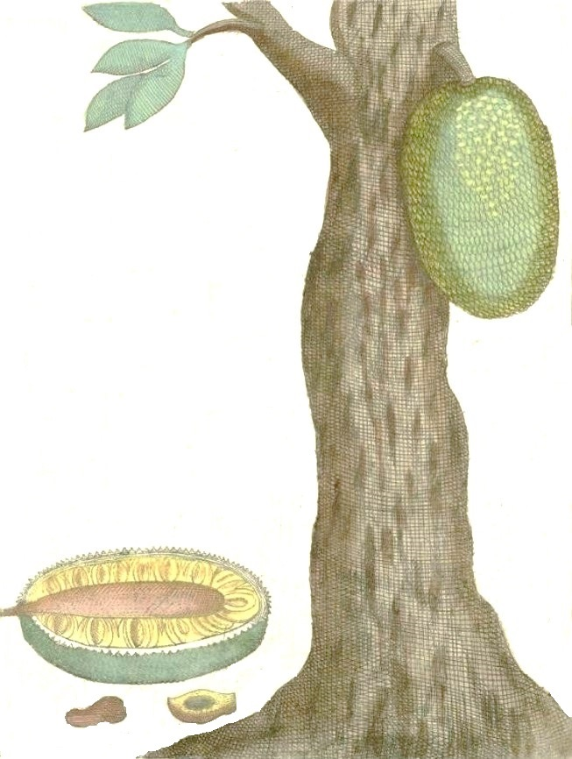

A Vegan Meat Substitute from Jackfruit

Slide 3
Fair Use Notice & Disclaimer
The information contained in this document is Confidential & Proprietary. It is prepared by Rootus Foods and the intellectual property of Rootus Foods. No one is allowed to reuse, reprint or republish such content in any form without our written consent. The information is intellectual property of Rootus Foods which has not always specifically authorized for use by third-party.

Slide 4
Background – Sustainability of Land & People
Trending Population - Health Conscious - Health Concerns
Innovation is the fuel - Healthy Alternatives are craved by consumers
Plant based products are gaining traction
Plant based meat substitutes are promising
Meat Consumption - More farm land to cultivate feed for animals - 20 vegetarians can live off the land required by one meat eater
Soil Erosion - Environmental Pollution from Meat Industry - Carbon Footprint Reduction
Growing plants takes much fewer resources than growing animals
Animal Cruelty & Prevention of diseases and their transmission
“Vegan food should be preferred not just for individual benefits but for the benefit to keeping our planet clean & sustainable for everybody including animals”

Slide 5
Key to Sustainability !
Innovation- Healthy Plant Based Alternatives
Soil Erosion- Pollution-Carbon Foot Print
Prevention of Animal Cruelty & Trasmission of Diseases
Vegetarianism & Land Conservation
Health Consciousness

Slide 6
Overgrazing by cattle is destroying the land & increasing desertification, nearly 430 million acres in the USA alone has suffered a 25-50% reduction in yield since first grazed.
90% of cattle ranches established on cleared forest land go bankrupt in less than 8 years as the land becomes barren due to nutrient loss & overgrazing.
Overgrazing by cattle is destroying the land & increasing desertification, nearly 430 million acres in the USA alone has suffered a 25-50% reduction in yield since first grazed. 25% of Central America's forests have been destroyed for cattle grazing since 1960
52% of greenhouse emissions come from animal agriculture
Every 3 seconds a child dies of starvation somewhere in the world
If Americans reduced their meat consumption by 10% it would free 12,000,000 tons of grain - enough to feed 60,000,000 people
If all Americans became vegetarian, it would free enough grain to feed 600,000,000 people
70% of all grain is fed to animals
Every year in the UK livestock is fed enough food to feed 250,000,000 people while in the world 30,000,000 people die of starvation
Vegans on average live 6 years longer than non-vegans
Vegetarians have a 20% lower rate of mortality from all causes
Vegetarians have a 40% reduced level of cancer than the general population
Vegetarians have 24% reduced risk of getting heart disease & Vegans a 57% reduction
Vegetarians have a 50% reduced risk of dying of diabetes
A British study indicates that a vegan diet reduces the risk for heart disease and Type 2 diabetes.
The world health organization recommends a diet low in saturated fat, sugar, salt & with plenty of fiber - exactly what you get on a vegan/vegetarian diet
The USFDA recognizes vegetarian and vegan diets as the healthiest diets

Slide 7

Overgrazing
Cattle ranches- Bankrupt
Deserification
Greenhouse gases
Child Mortality
Downplay meat consumption
Vegetarianism- Free grain
Vegan’s Lifespan
Lower mortality
Reduced cancer level
Reduced heart risk
Reduced diabetic risk

Slide 8
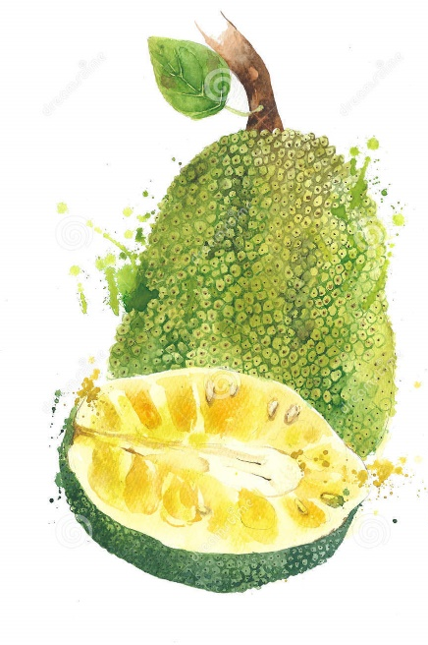
Addressing The Need
“Vegans are most likely to live longer with low mortality due to various health benefits .
Vegan diets are considered to be healthy compared to meat based”
The Opportunity

Slide 9
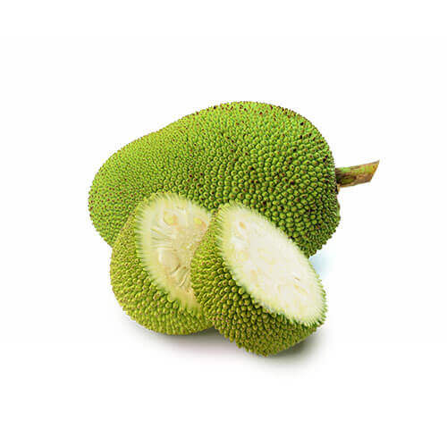
Meet – Meaty Jack
Botanical Name : Artocarpus Heterophyllus
Common Name : Jackfruit / Breadfruit
It is a tropical fruit widely and wildly grown in India, Bangladesh, Vietnam, Srilanka and some other tropical countries
Mature ripe fruit arils are consumed raw – fruity flavour with distinct aroma
Mature raw fruit can be cooked and consumed

Slide 10

Why Jackfruit
It’s an abundant, sustainable and biodiverse fruit that is largely wasted as a resource
(around 65% of the fruit gets wasted every year and only 8% is commercialized)
It is neutral in taste and so goes well with all kinds spices and flavours
It is a promising meat substitute not just in terms of Taste but also in terms of Nutrition, Physical and Sensory Attributes
Wonderfully nutritious with high fibre levels, no cholesterol, low fat and low calories
Jackfruit trees are naturally pest & disease resistant making them naturally organic – drought resistant as well
Less price
Rich in Vitamins & Minerals
Excellent source of Omega 3 Fatty Acids
High in Antioxidants – Anti Carcinogenic
Boosts Immunity, Lowers Blood Pressure, Supports Digestion
Rich in Magnesium, Potassium, Calcium among others – Reduces Heart Diseases
Controls Diabetes

Slide 11
Pyramid Chart
Rich in vitamins and minerals
Source of Omega-3 fatty acids
High in antioxidants
Rich in Mg, K, Ca and reduces heart attacks
Controls Diabetes

Slide 12



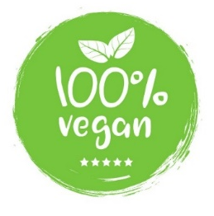
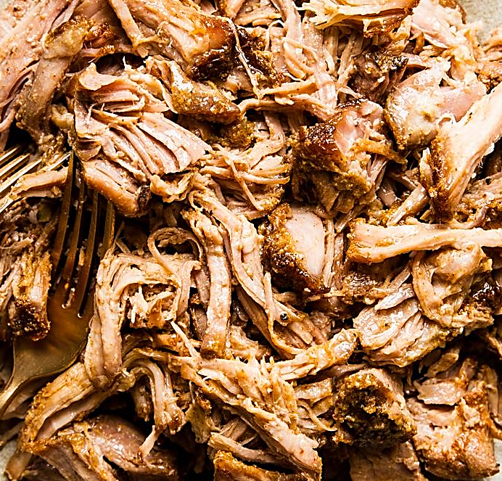
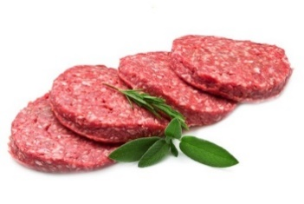
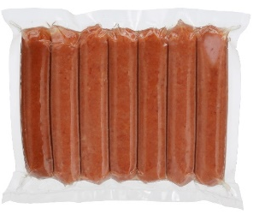
Product Portfolio
Mature Jack
Cooked Raw Jack
Burgers
Sausages
No Artificial Flavours
No Artificial Colours
No Preservatives
Minimally Processed
All the products are Vacuum Packed to retain all that is good and are Ready-To-Cook
we have a secret protein ingredient and of course its Vegan

Slide 13
Who We Are
Rootus Foods is an Indian based company led by a team of enthusiastic food entrepreneurs who have core management skills and sound technical knowledge. We are committed to revolutionize the agriculture sector through continuous investment of innovations and industrial intervention. Rootus Foods’ commitment is a realization of the impact of agriculture on mankind. At Rootus Foods, we don’t solely focus on enterprising agriculture, but also consider the need and necessity to enhance rural lifestyle by providing better scope for livelihood.
Rootus Foods’ uses sustainability as the umbrella term to describe responsible business operations which include economic, environmental and social responsibility. We are committed to manage and develop our business in a sustainable manner and recognize that balancing these three aspects on a sustainable basis is a necessity to create long-term value for all our stakeholders.
Rootus Foods’ believes in the concept of partnering with farmers. We educate them through the processes and value addition which immensely influence and immediately transform farmers both qualitatively and economically. Our motive to make every farmer a stake holder framed up our business model.

Slide 14
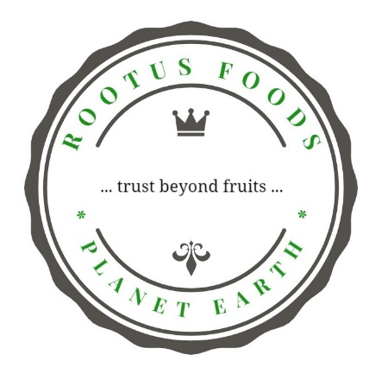
Rootus Foods is committed to ethical sourcing of raw material. We had tied up with local farmers and agricultural departments and ethically streamlined the process of sourcing. The peeled rind and other wastage from the jackfruit is converted to organic manure. We aim to encourage farmers towards organic farming and to facilitate this, we would distribute organic manure to the farming community as part of our CSR.
Rootus Foods is committed to ethical sourcing of raw material. “Feed the Feeder” is our prospective initiative to make sure that all the stakeholders in our raw material supply chain are deservingly paid.
Thank You

